Slide 1
Legal Issues
As user interfaces have become more prominent in society, serious legal issues have emerged. Every developer of software and information should review legal issues that may affect design, implementation, deployment, marketing, and use. For more information, Baase (2013) gives an in-depth overview of such social, legal, philosophical, ethical, political, constitutional, and economic implications of computing.
Privacy and security are always a concern whenever computers are used to store data or to monitor activity. Medical, legal, financial, and other data often have to be protected to prevent unapproved access, illegal tampering, inadvertent loss, or malicious mischief.

Slide 2
A second concern encompasses safety and reliability. User interfaces for aircraft, automobiles, medical equipment, military systems, utility control rooms, and the like can affect life-or-death decisions. If air traffic controllers are confused by the situation display, they can make fatal errors. If the user interface for such a system is demonstrated to be difficult to understand, it could leave the designer, developer, and operator open to a lawsuit alleging improper design

Slide 3
A third issue is copyright or patent protection for software (Lessig, 2006; Samuelson and Schultz, 2007; McJohn, 2015). Software developers who have spent time and money developing a package are understandably frustrated when potential users make illegal copies of the package rather than buying it. Technical schemes have been tried to prevent copying, but clever hackers can usually circumvent the barriers. It is unusual for a company to sue an individual for copying a program, but cases have been brought against corporations and universities

Slide 4
A fourth concern is with copyright protection for online information, images, or music. If customers access an online resource, do they have the right to store the information electronically for later use? Can the customer send an electronic copy to a colleague or friend? Who owns the “friends” list and other shared data in social networking sites? Do individuals, their employers, or network operators own the information contained in e-mail messages? The expansion of the web, with its vast digital libraries, has raised the temperature and pace of copyright discussions

Slide 5
A fifth issue is freedom of speech in electronic environments. Do users have a right to make controversial or potentially offensive statements through e-mail or social media? Are such statements protected by freedom of speech laws, such as the U.S. First Amendment? Are networks similar to street corners, where freedom of speech is guaranteed, or are networks similar to television broadcasting, where community standards must be protected? Should network operators be responsible for or prohibited from eliminating offensive or obscene jokes, stories, or images? Controversy has raged over whether Internet service providers have a right to prohibit e-mail messages that are used to organize consumer rebellions against themselves

Slide 6
Other legal concerns include adherence to laws requiring equal access for users with disabilities and attention to changing laws in countries around the world. Do Yahoo! and eBay have to enforce the laws of every country in which they have customers? These and other issues mean that developers of online services must be sure to consider all the legal implications of their design decisions

Slide 7
Direct manipulation
Direct manipulation as a concept has been around since before computers. The metaphor of direct manipulation works well in computing environments and was introduced in the early days of Xerox PARC and then widely disseminated by Shneiderman (1983). Direct-manipulation designs can provide the capability for differing populations and easily stretch across international boundaries

Slide 8
favorite example of direct manipulation is driving an automobile. The scene is directly visible through the front window, and performance of actions such as braking and steering has become common knowledge in our culture. To turn left, for example, the driver simply rotates the steering wheel to the left. The response is immediate and the scene changes, providing feedback to refine the turn. Now imagine how difficult it would be trying to accurately turn a car by typing a command or selecting “turn left 30 degrees” from a menu. The graceful interaction in many applications is due to the increasingly elegant application of direct manipulation.

Slide 9
Driverless cars may soon respond to commands like “take me to Baltimore airport,” but they are a long way from matching the skills of drivers at the wheel while navigating snow-covered roads or police hand signals at accident sites

Slide 10
Before designing for current devices, it makes sense to reflect where early design has been. In the early days of office automation, there was no such thing as a direct-manipulation word processor or a presentation system like PowerPoint. Word processors were command-line–driven programs where the user typically saw a single line at a time. Keyboard commands were used along with inserting special commands to provide instructions for viewing and printing the documents often as a separate operation. Similarly, with presentation programs, specialized commands were used to set the font style, color, and size. Obviously, these were very limited compared to the numerous font families available today. Most users today are used to a WYSIWYG (What You See Is What You Get) environment enhanced by direct-manipulation widgets.

Slide 11
The three principles and attributes of direct manipulation
The attraction of direct manipulation is apparent in the enthusiasm of the users. Each example has problematic features, but they demonstrate the potent advantages of direct manipulation, which can be summarized by three principles:
1. Continuous representations of the objects and actions of interest with meaningful visual metaphors
2. Physical actions or presses of labeled interface objects (i.e., buttons) instead of complex
3. Rapid, incremental, reversible actions whose effects on the objects of interest are visible immediately

Slide 12
Using these three principles, it is possible to design systems that have these beneficial attributes:
Novices can learn basic functionality quickly, usually through a demonstration by a more experienced user.
Experts can work rapidly to carry out a wide range of tasks, even defining new functions and features. Knowledgeable intermittent users can retain operational concepts.
Error messages are rarely needed.
Users can immediately see whether their actions are furthering their goals, and if the actions are counterproductive, they can simply change the direction of their activity.
Users experience less anxiety because the interface is comprehensible and because actions can be reversed easily.
Users gain a sense of confidence and mastery because they are the initiators of action, they feel in control, and they can predict the interface’s responses.

Slide 13
Translational distances with direct manipulation
The effectiveness and reality of the direct-manipulation interface are based on the validity and strength of the metaphor chosen to represent the actions and objects. Using familiar metaphors creates easier learning conditions for users and lessens the number of mistakes and incorrect actions. Adequate testing is needed to validate the metaphor. Special attention needs to be paid to the user characteristics such as age, reading level, educational background, prior experiences, and any physical disabilities.

Slide 14
Examples of translational distances (strength).
Weak—early video game controllers (Fig. 7.5)
Medium—touch screens, multi-touch (Fig. 7.1)
Strong—data glove, gesturing, manipulating tangible objects (Fig. 7.2)
Immersive—virtual reality, i.e, oculus rift (Fig. 7.14)

Slide 15
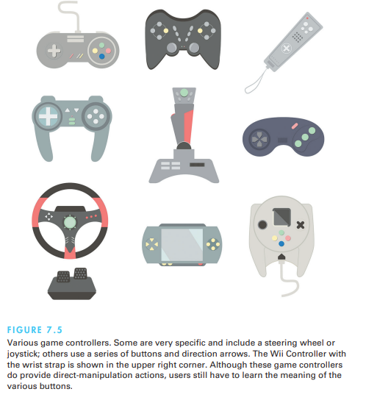

Slide 16
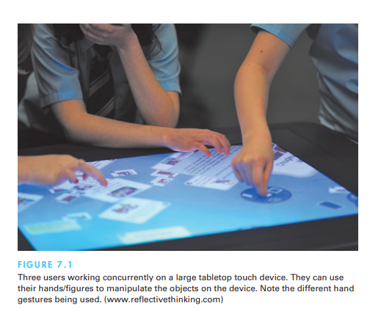

Slide 17
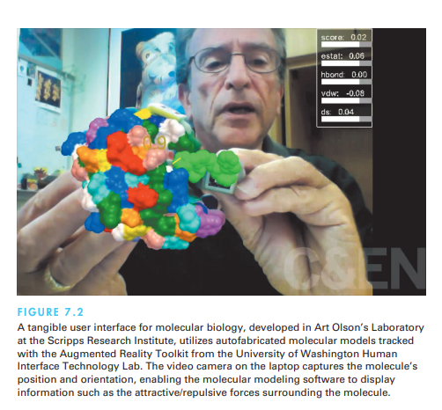

Slide 18
Weak direct manipulation is what can be described as basic direct manipulation. There is a mouse, trackpad, joystick, or similar device translating the user’s physical action into action in the virtual space using some mapping function.

Slide 19
Medium direct manipulation is the next step moving along the continuum. The translational distance is reduced. Instead of communicating with the virtual space with the device, the user reaches out and touches, moves, and grabs the entities in the on-screen representation. Examples of this include touchscreens (mobile, kiosk, and desktop).
strong direct manipulation involves actions such as gesture recognition with various body parts. It may be the user’s hand, foot, head, or full body (whatever controls the action) that is “virtually” placed inside the physical space

Slide 20
Disadvantages of Direct manipulation
May be hard to code.
High resource usage.
The requirement for a lot of screen space may be cumbersome.
Poing may be slower than typing.
May increase difficulty for the visually impaired.
May require graphics display and pointing devices.

